Slide 1
Burnt Toast
By Team Platypus
Duong Chau
Griffin Harris
David Larson
Joseph Sturtevant
Bernie Wong

Slide 2
Concept Idea
Turn based RPG
Strategic combat with emphasis on resource management
Cartoon world, quirky characters
Low barrier to entry
Notes:
Mention it to be similar to EarthBound, Paper Mario, or the Mario & Luigi RPGs where they are easy to pick up and learn, the world is fun and easy to get involved in, and the mechanics are so simple a person new to video games should be able to play.

Slide 3
Audience
Two audiences
Youth 10-14 intrigued by emphasis on cartoon visuals
Young adult 18-22 who are familiar with a traditional RPG system
For RPG gamers, and gamers who would like to play RPG’s but want something more accessible

Slide 4
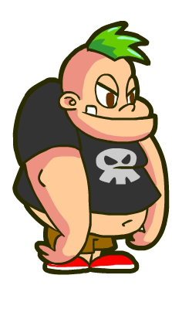
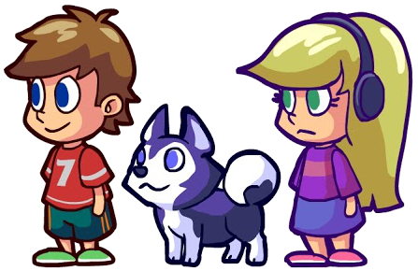
Context/Narrative
Luke, Izzy, and Yogurt have to survive the many dangers of their town as they try to make it through the last day of school before summer break!

Slide 5
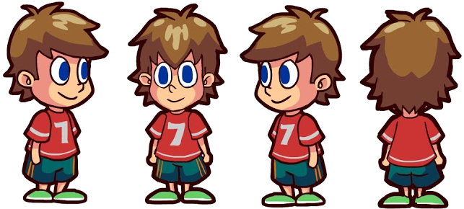
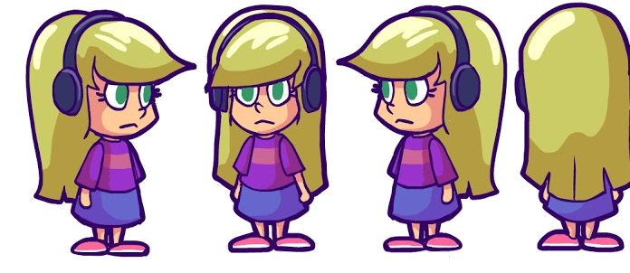
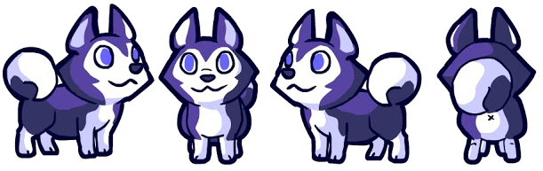
Aesthetics
What will it look like?
EarthBound
Paper Mario
Cartoon look
weapons
enemies
attack animations
Notes:
Explain it to be Like Paper Mario/Mario RPG or earthbound in that they would look like a Saturday morning cartoon.

Slide 6
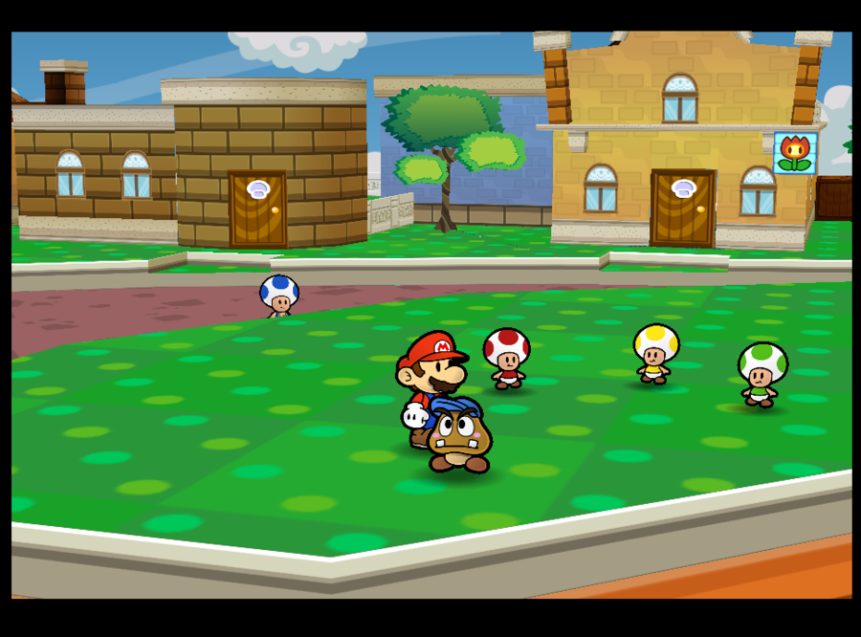
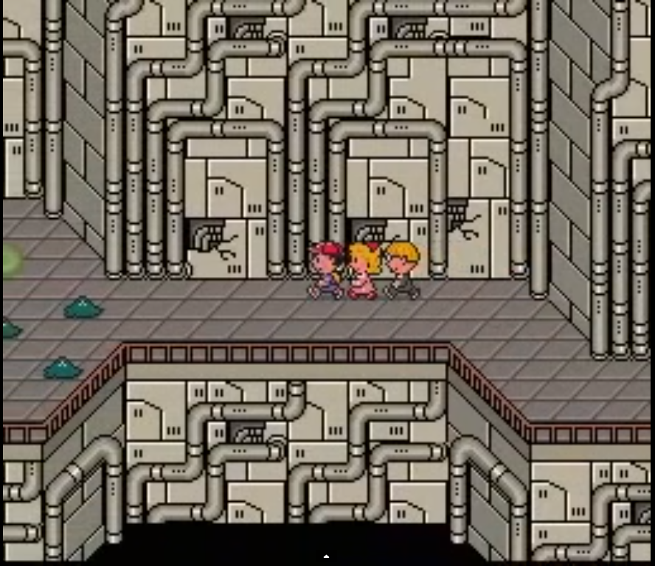
Overworld
2.5 D
Interactable objects and NPCs
Exploration
Party formation
Order matters!
Watch out for enemies!
Paper Mario
EarthBound
Notes:
GRIFFIN: - 2.5D navigation
Allows a lot of exploration in relatively small scenes
Have dialogue interaction with friendly NPCs
Easy transitions from combat to overworld and vise versa
Interactable objects (open doors/gates, platforming?)
How it will be implemented
-Allies
Follow leader
Line order reflects battle formation

Slide 7
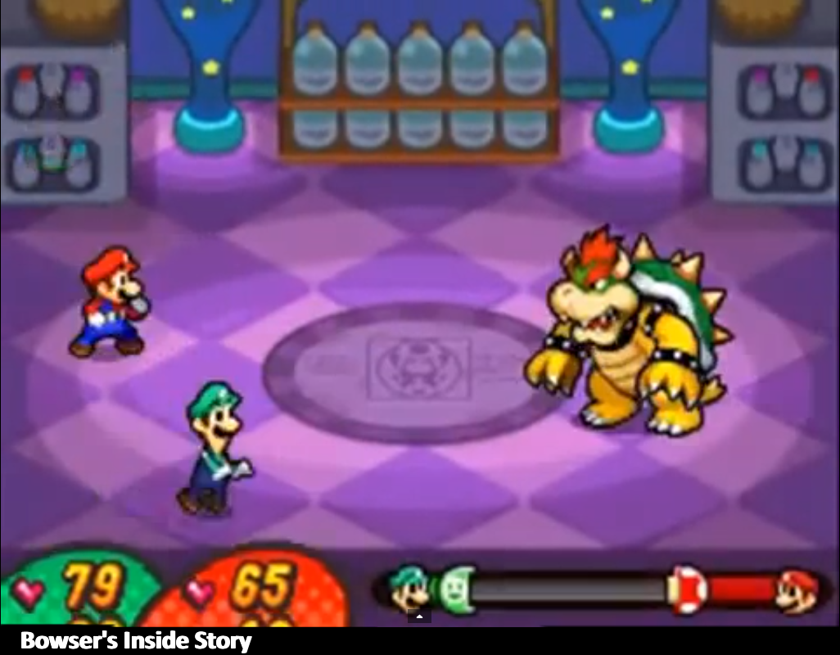
Battle System
Turn based
3 man Party
unique toolsets
Strategy pays off!
Notes:
JOE:
-Turn based strategy
like classic RPGs, this helps new players understand
Timing attacks right will increase the power of your attacks just like in the Mario & Luigi RPGs/Paper Mario games
-Three character party
Lovable characters each with their own role and playstyle
New players will love the characters, Veterans will love their playstyles

Slide 8
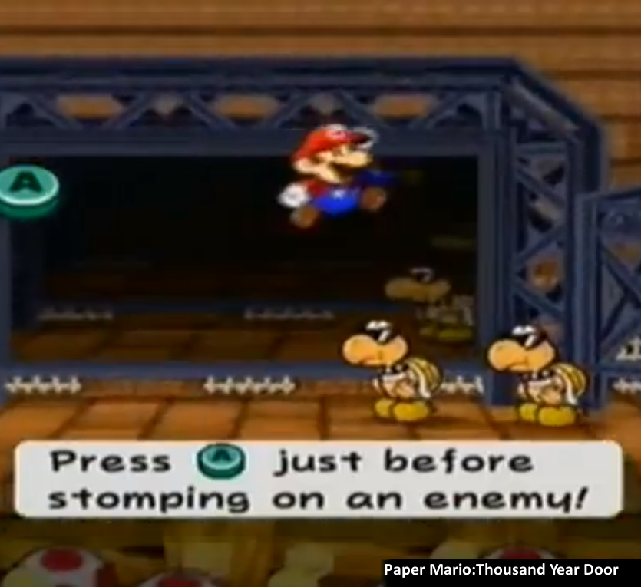
Battle System Continued
Unique twist on “Mana”
Two Row Combat
“rest mode”
“combat mode”
Timed attacks
Notes:
-Resource Management and Back Row
RESOURCE INFO: characters have their own version of ‘mana/MP/energy’ that may recharge differently or have different effects when depleting.
ROTATION INFO: Works similar to Pokemon’s rotation style battle but two heroes are fighting instead of one.
Heroes in Back Row is defending and/or regaining energy
New spin on the formula is easy to pick up by new players and an interesting twist for veterans to master

Slide 9
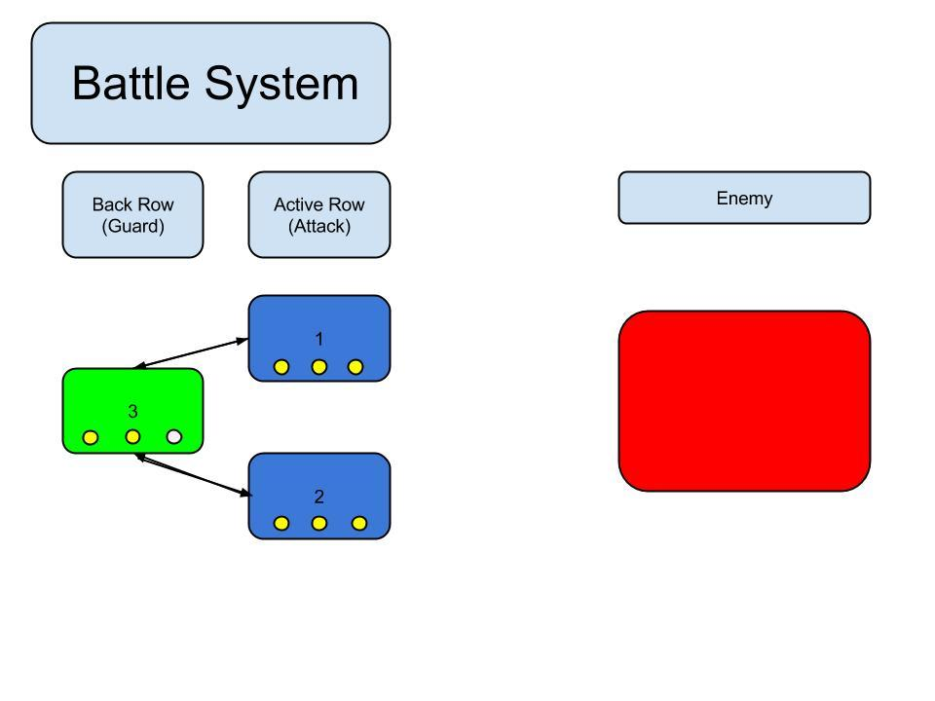
Diagram

Slide 10
Prototype
2.5D
Battle System
Menu
World/NPC Interaction
Shop/Economy
Quest Log

Slide 11
Risk Analysis
2.5 D
Time consumption
Enemy Behavior
Ability choice
Balancing
Player vs Enemy ability balancing
Item usage
Level Design
Quest design
Economy
Rewards and resources management

Slide 12
Looking Forward
Building a narrative that feels fresh
Constructing an engaging battle system with balance tweaks for complexity
Interactable environment that rewards players for exploring

Slide 13
Video
http://vimeo.com/93360557

Slide 14
Thank you!
Any Questions?

